Slide 1
Cooking with AWS and Splunk
Module 12 : Setting Up AWS Guard Duty
Kam Amir | Splunk Cloud Architect

Slide 2
Agenda
Setup AWS Guard Duty
Configure Lambda Function (use splunk-logging function)
Configure CloudWatch Events
Setup SQS Based S3 for S3 data collection
Generate Sample Events

Slide 3
Setup AWS Guard Duty

Slide 4
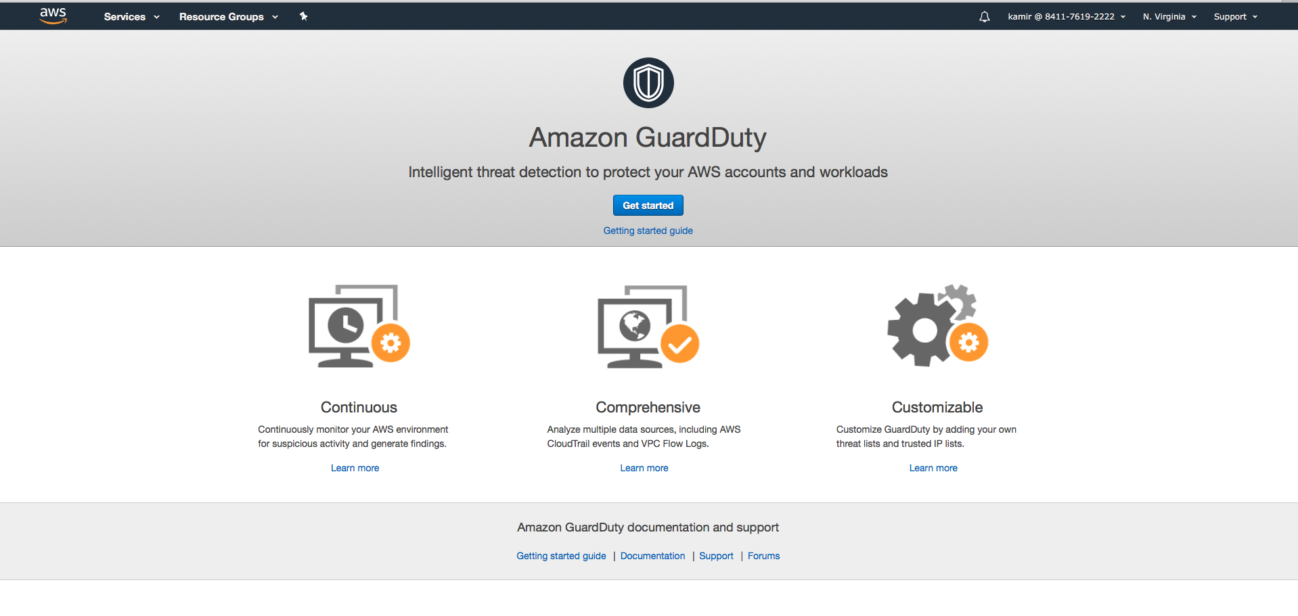
Setup Guard Duty 1 of 5

Slide 5
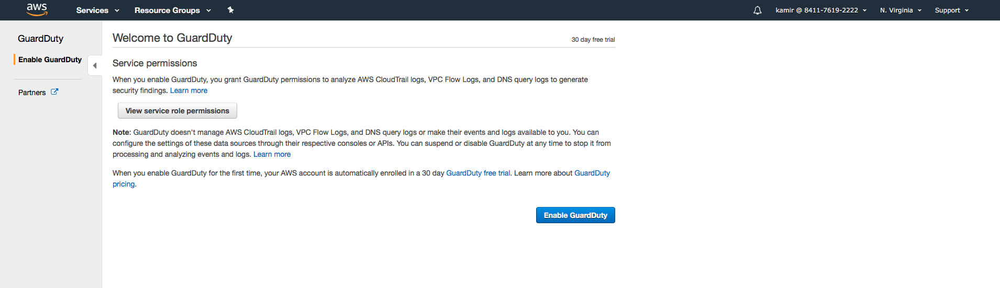
Setup Guard Duty 2 of 5

Slide 6
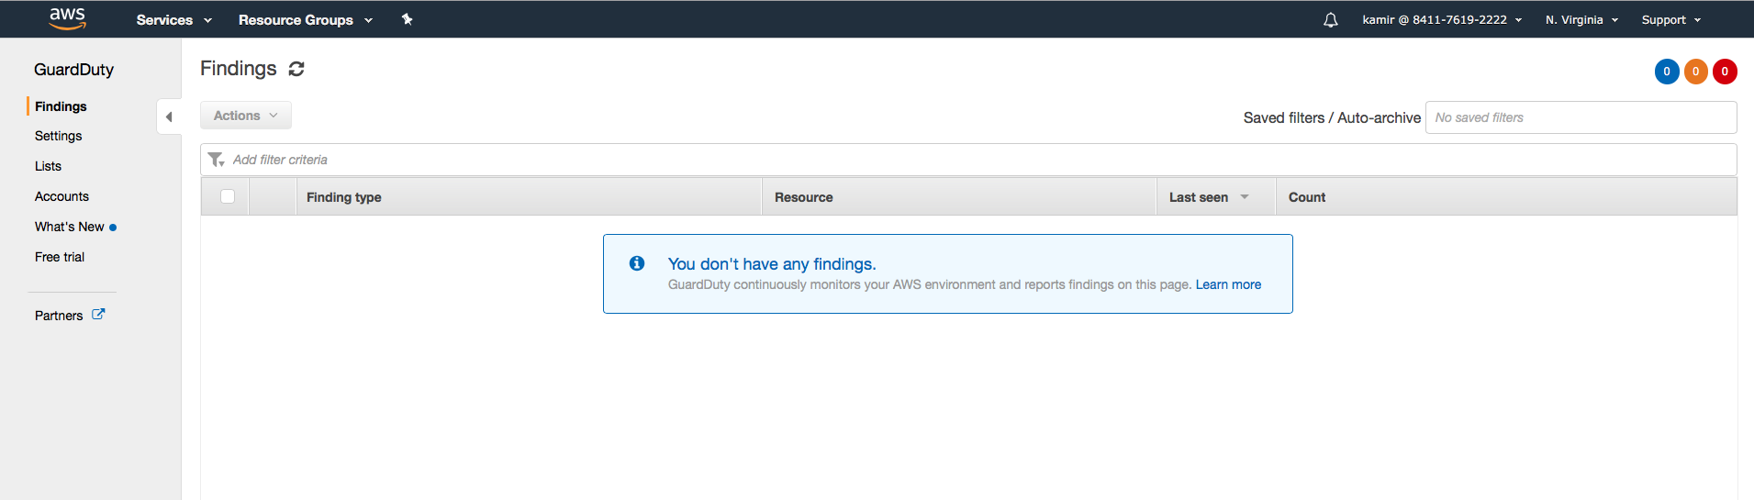
Setup Guard Duty 3 of 5

Slide 7
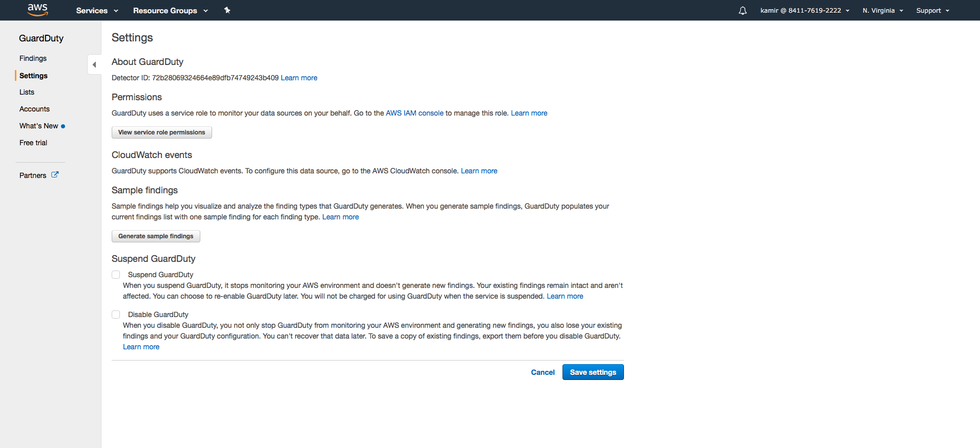
Setup Guard Duty 4 of 5

Slide 8
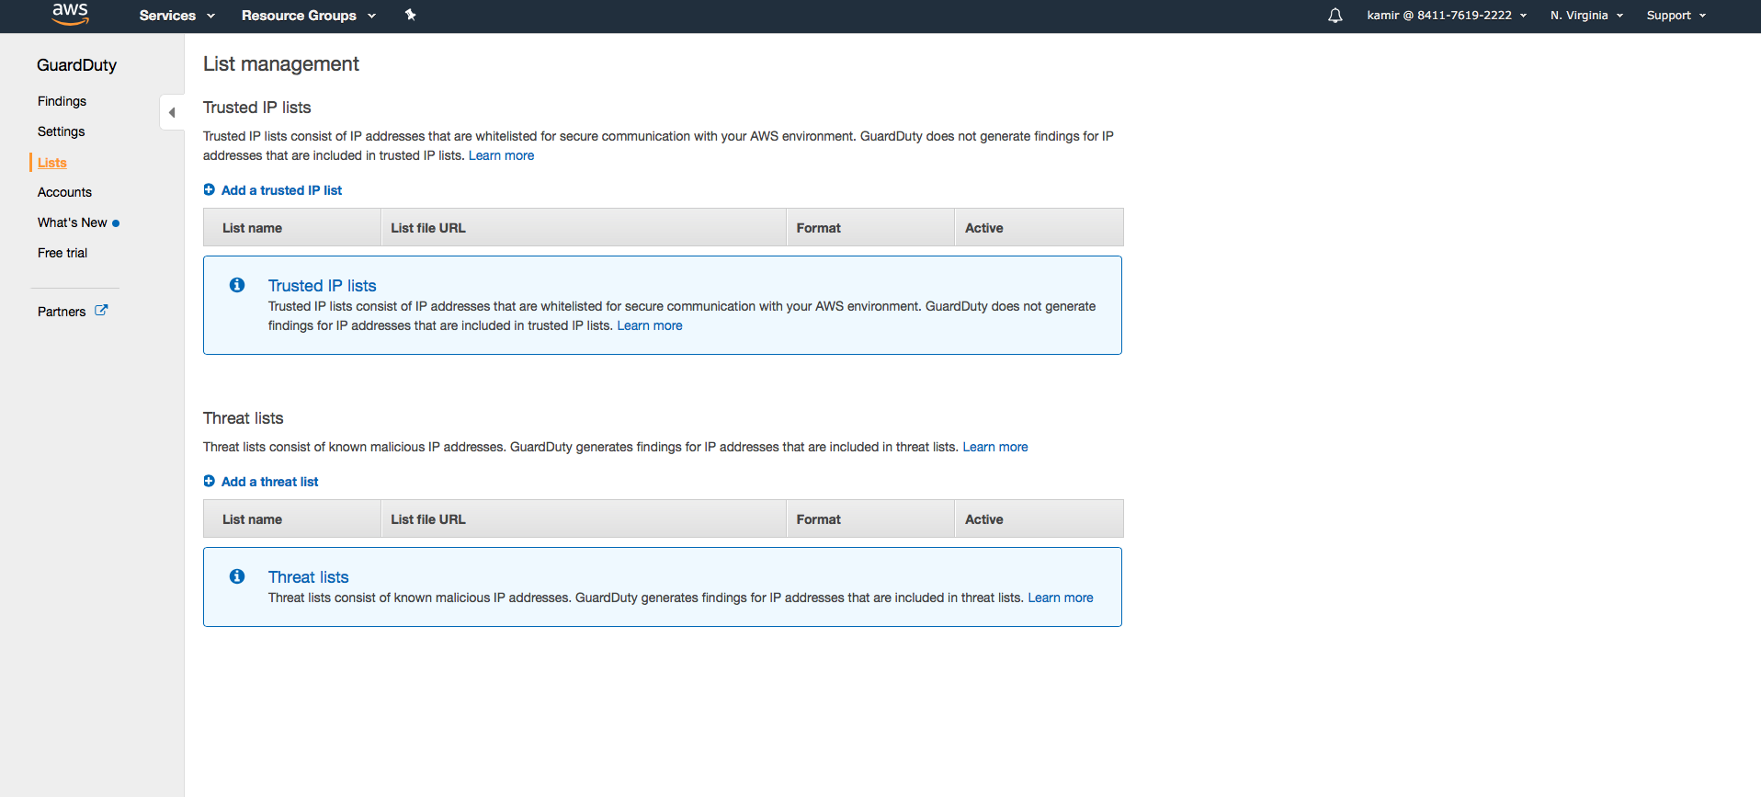
Setup Guard Duty 5 of 5

Slide 9
Configure Lambda Function

Slide 10
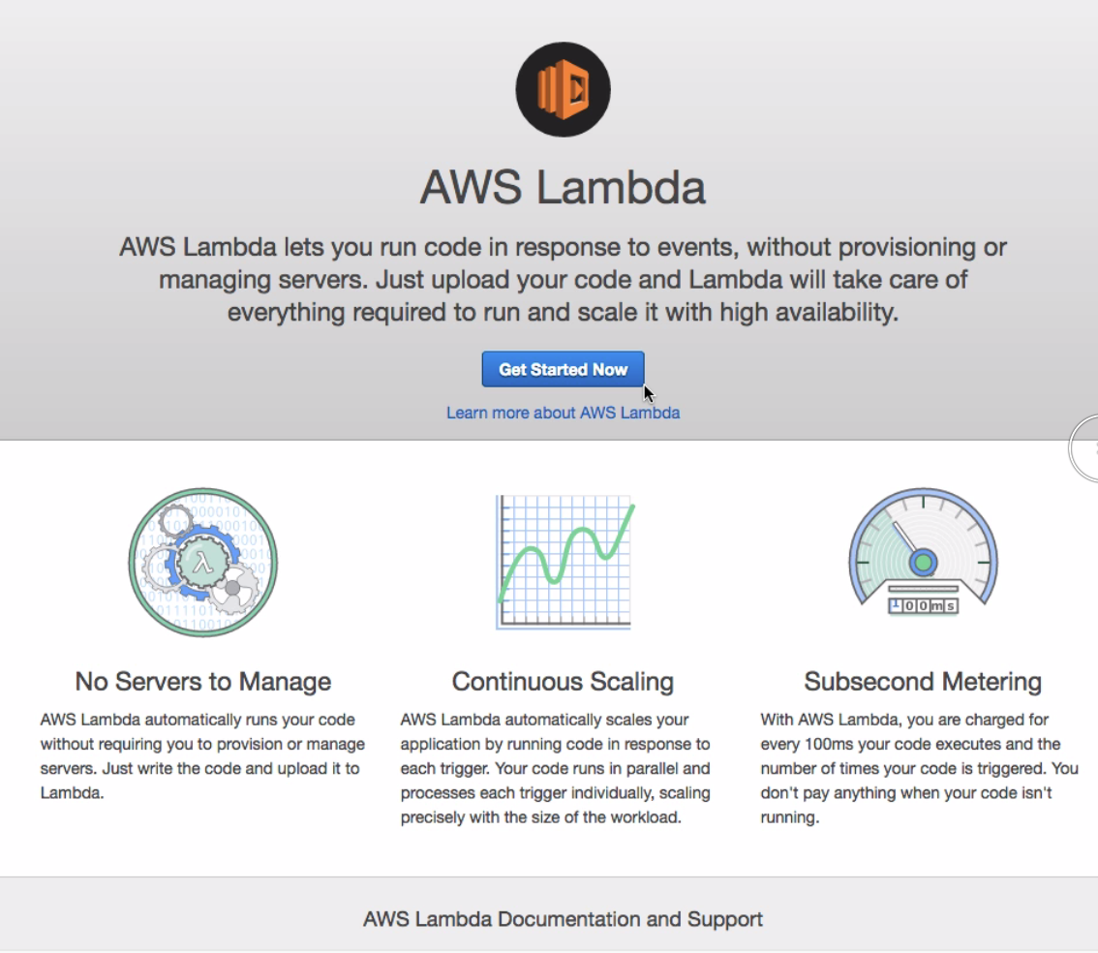
Create Lambda Function 1 of 7

Slide 11
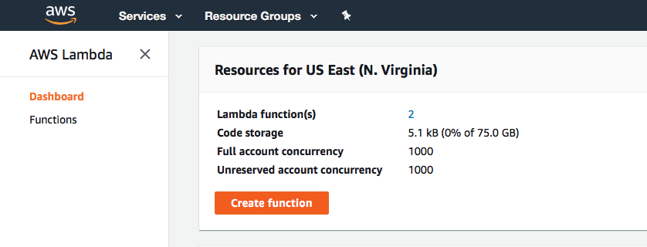
Create Lambda Function 2 of 7
Click Create Function

Slide 12
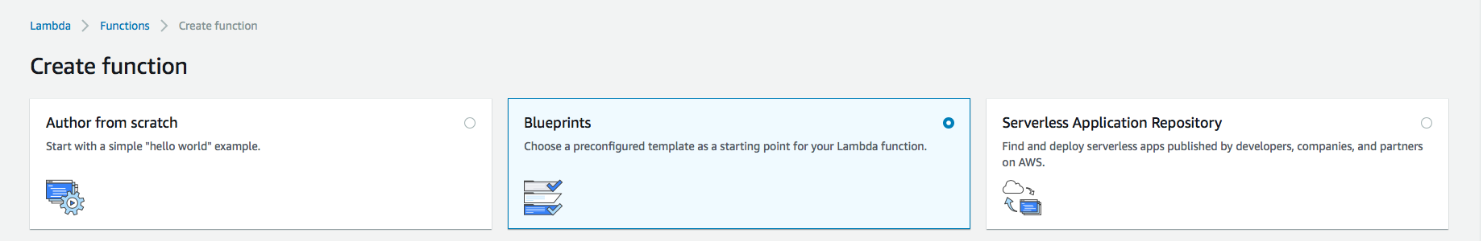
Create Lambda Function 3 of 7
Click “Blueprints”

Slide 13
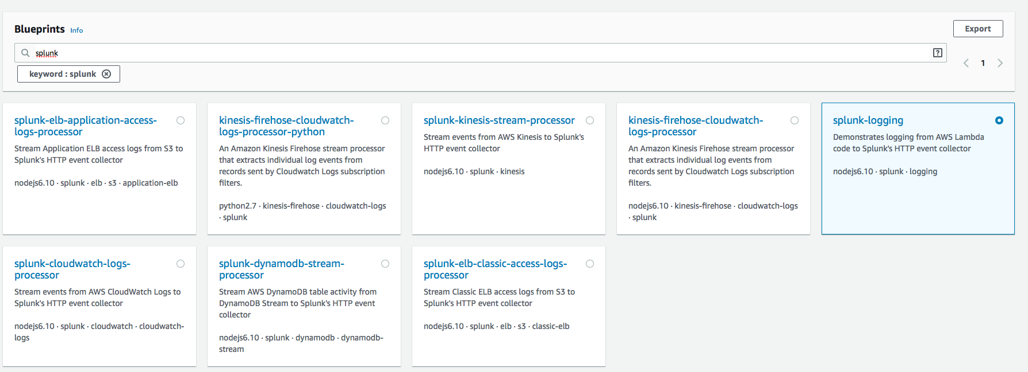
Create Lambda Function 4 of 7
Search for ‘splunk’ and select ‘splunk-logging’ function

Slide 14
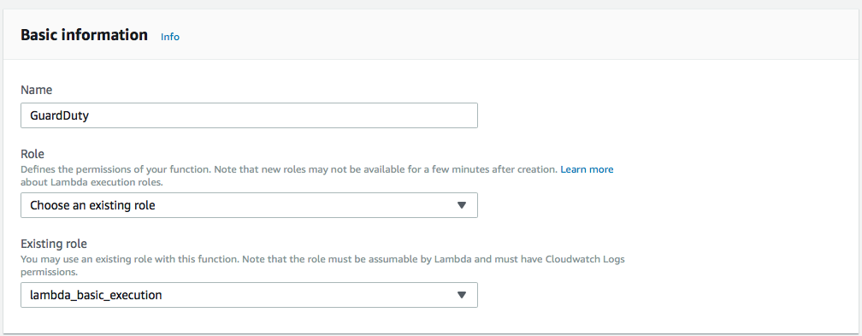
Create Lambda Function 5 of 7
Enter basic information

Slide 15
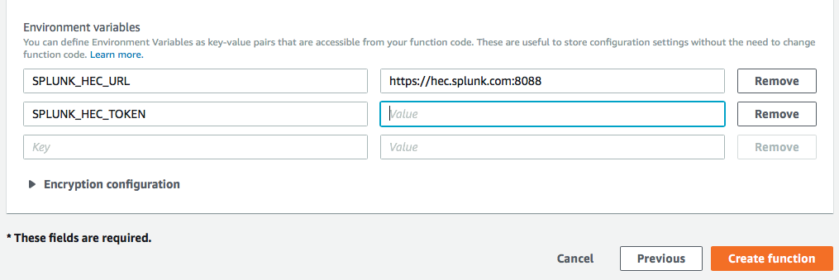
Create Lambda Function 6 of 7
Fill in the HEC URL and HEC Token and click “Create function”
/collector/services/
<your token here>

Slide 16
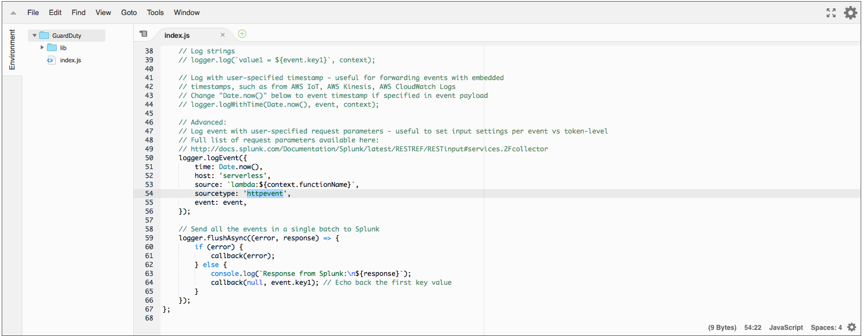
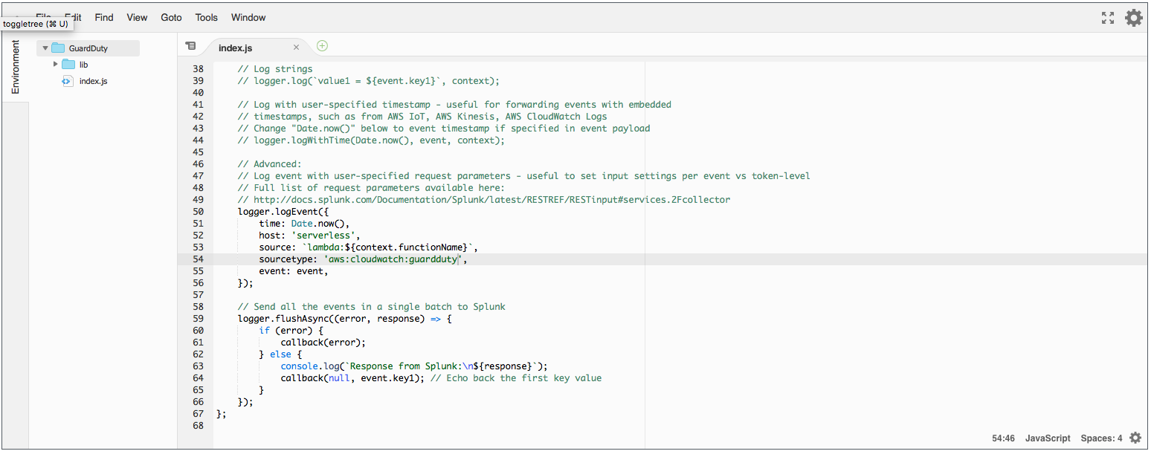
Create Lambda Function 7 of 7
Edit the sourcetype in line 54 change from ‘httpevent’ to ‘aws:cloudwatch:guardduty’

Slide 17
Configure CloudWatch Events

Slide 18
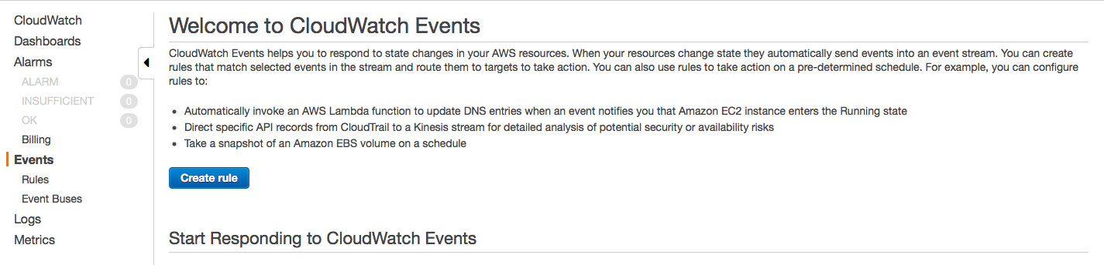
Configure CloudWatch Events
Click on Events and Create Rule

Slide 19
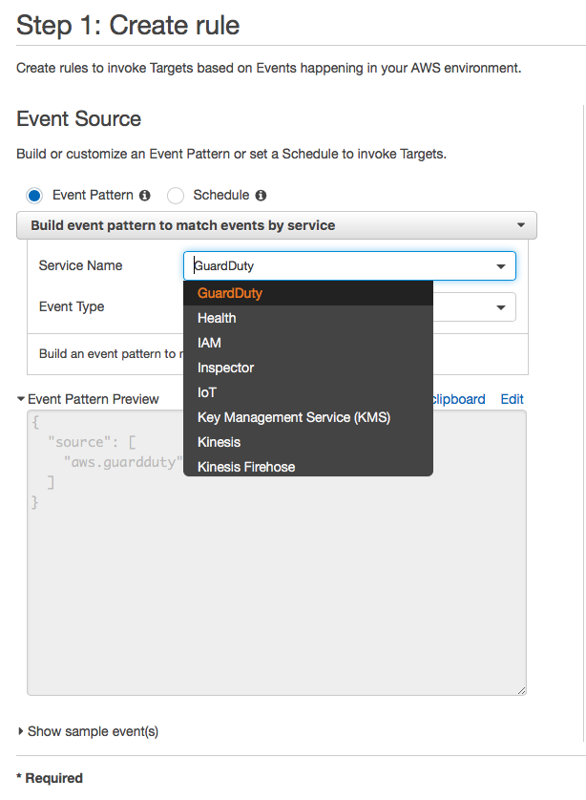
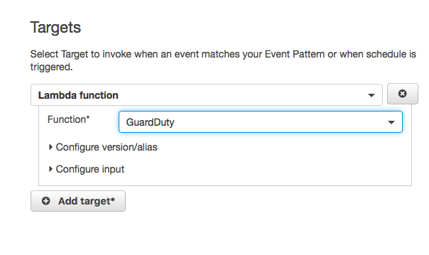
Configure CloudWatch Events 2 of 4
Select GuardDuty Service and select the Lambda function created earlier

Slide 20
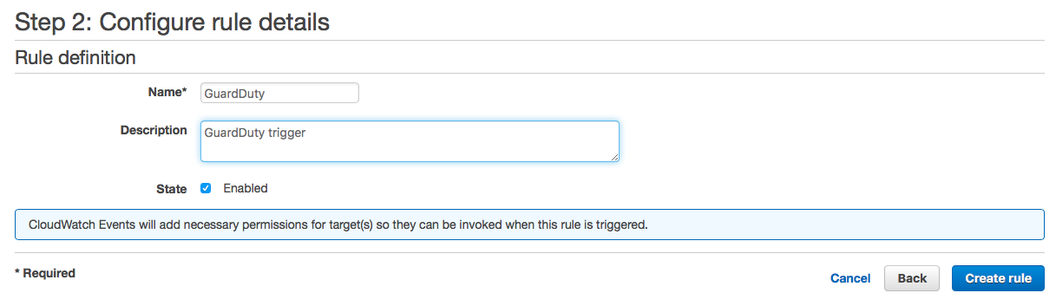
Configure CloudWatch Events 3 of 4
Configure the rule details and Create rule

Slide 21
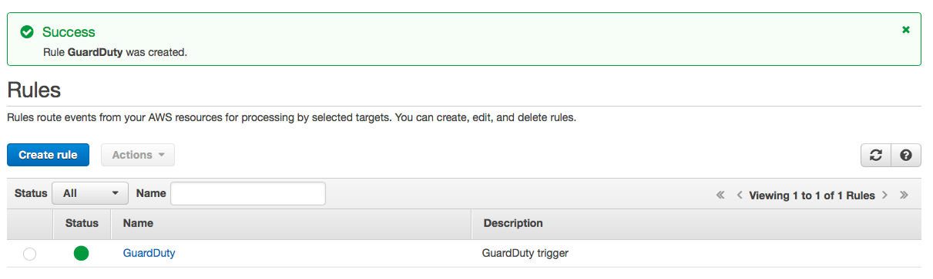
Configure CloudWatch Events 4 of 4
Validate Rule was created

Slide 22
Setup SQS Based S3 for S3 data collection

Slide 23
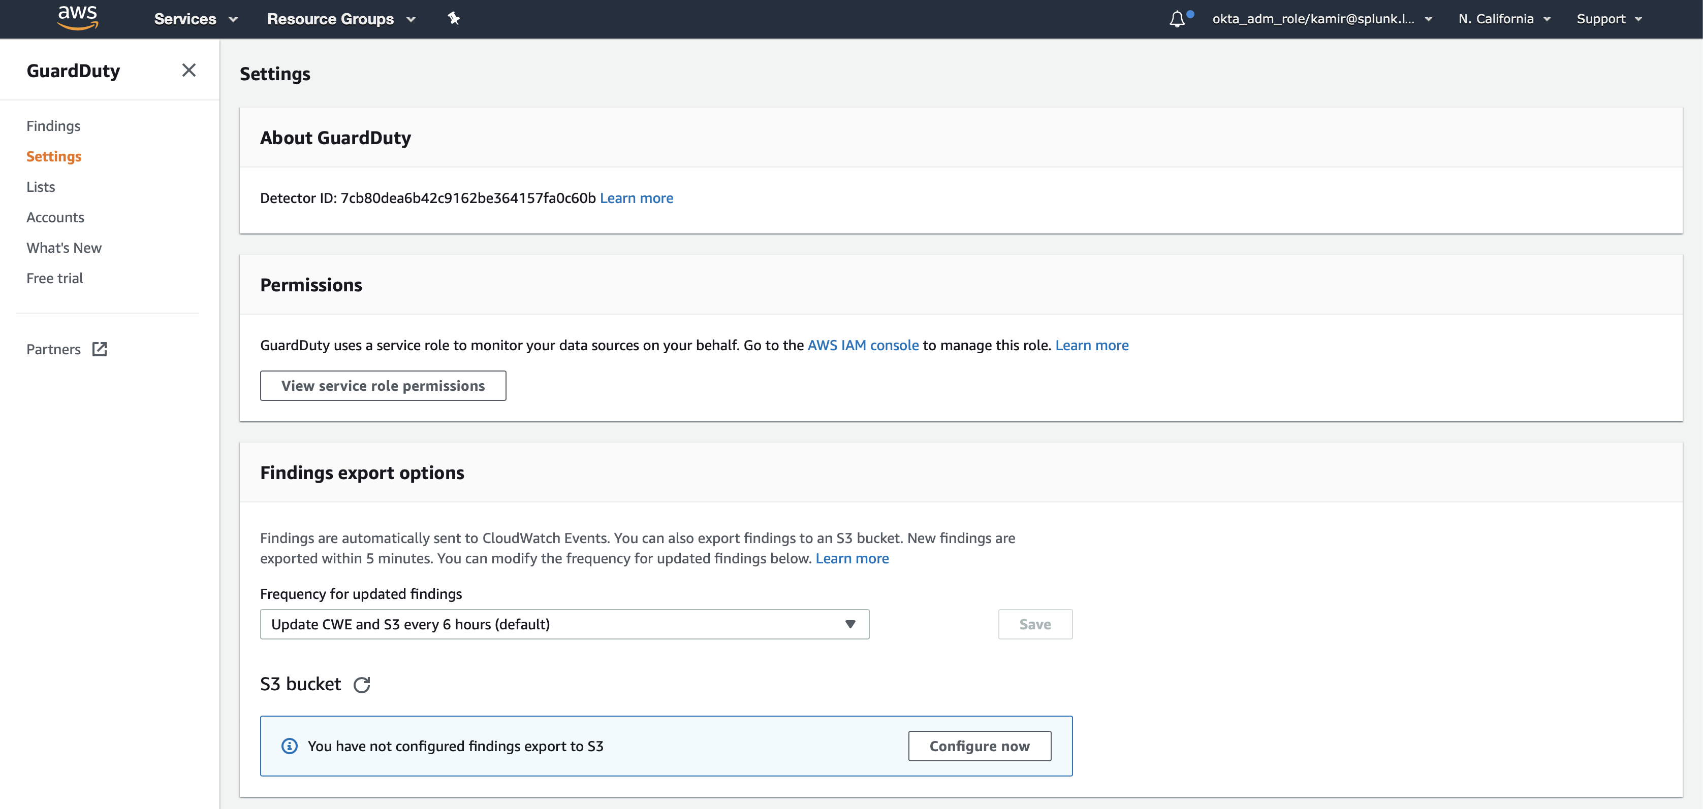
Setup S3 bucket on GuardDuty
Step 1 - Click on Configure now if you want to send your data to an S3 bucket

Slide 24
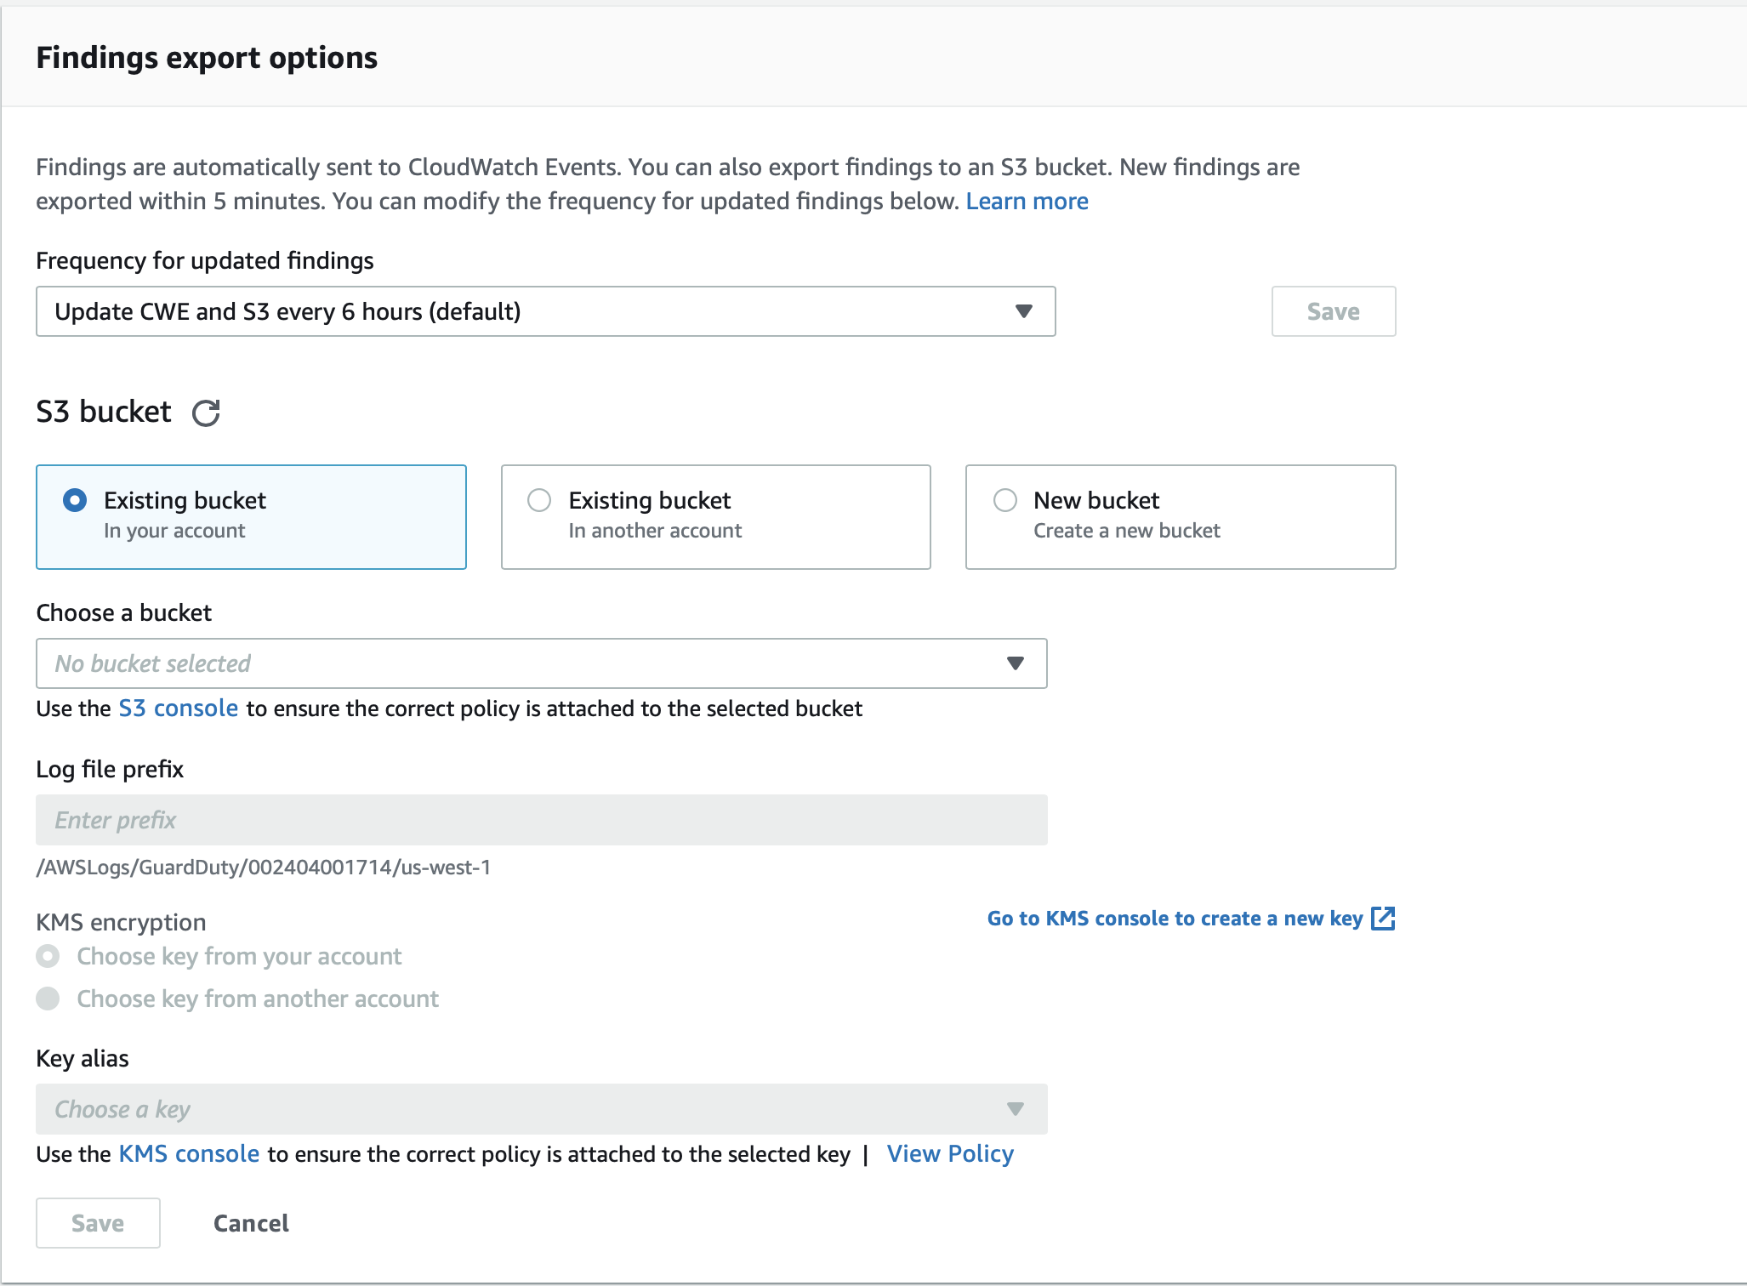
Setup S3 bucket on GuardDuty
Step 2 – Either select an existing S3 bucket or create a new one

Slide 25
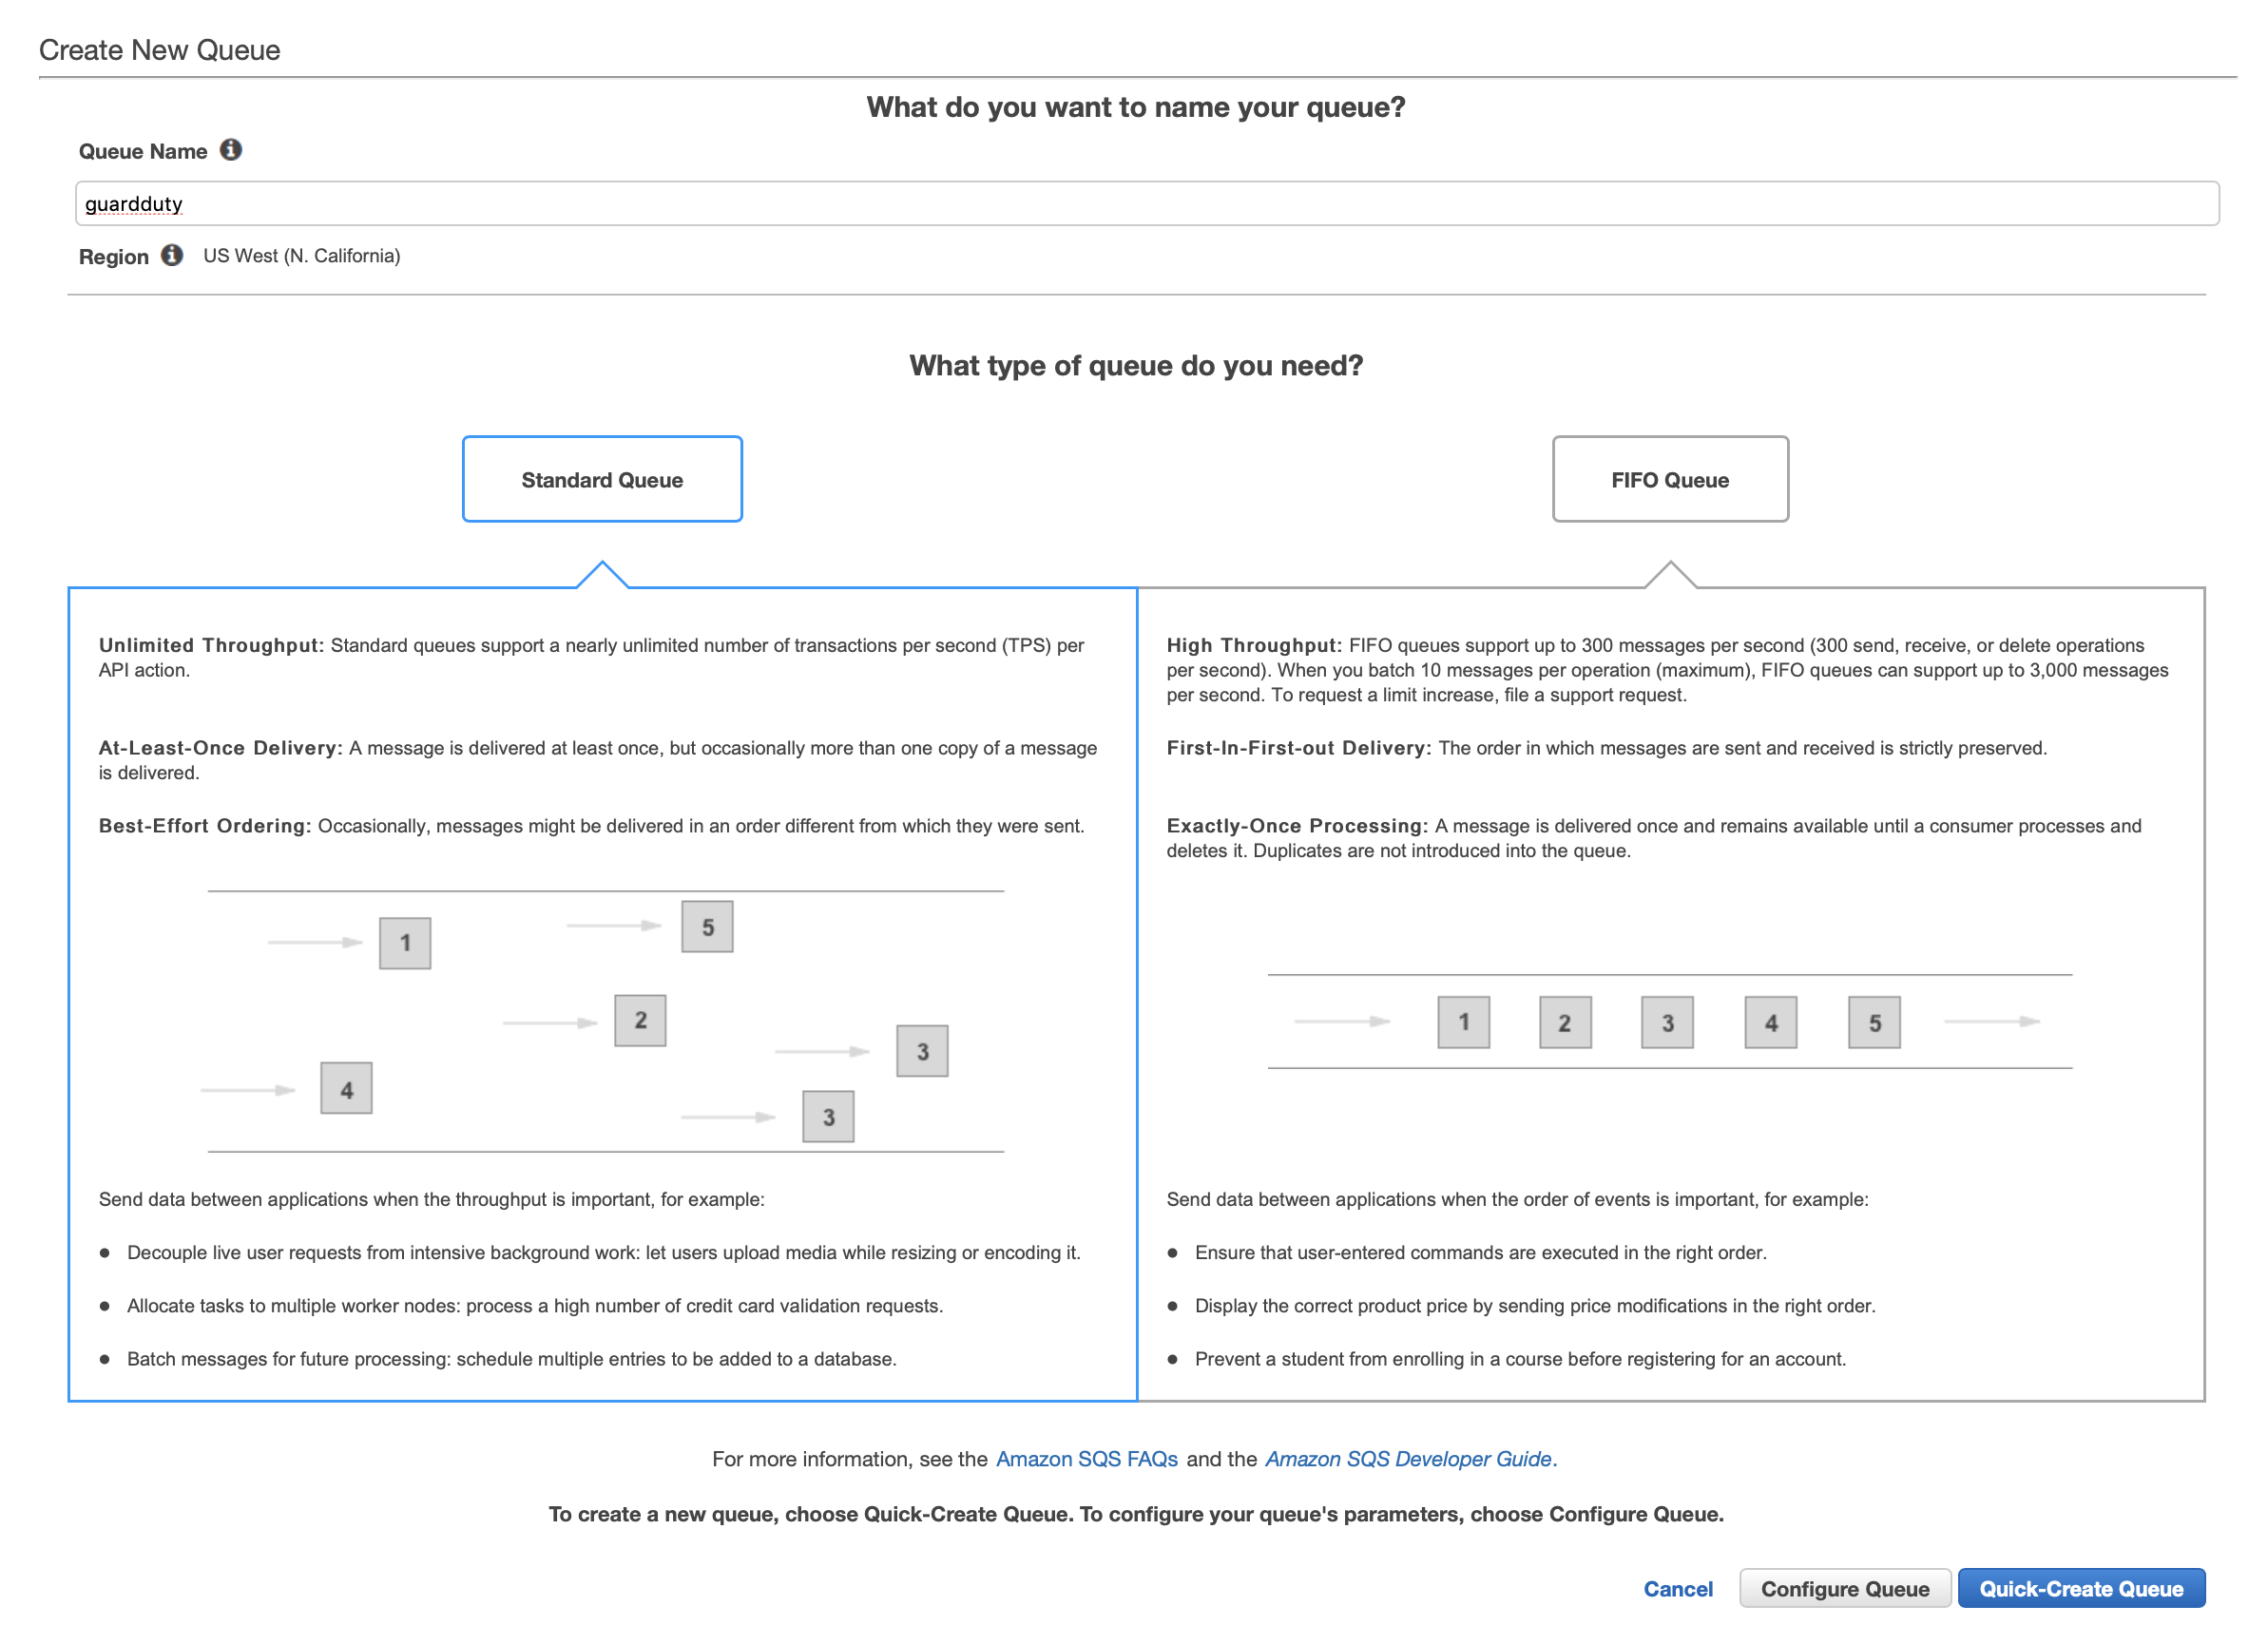
Setup S3 bucket on GuardDuty
Step 3 – Create SQS Queue “guardduty” for GuardDuty Events

Slide 26
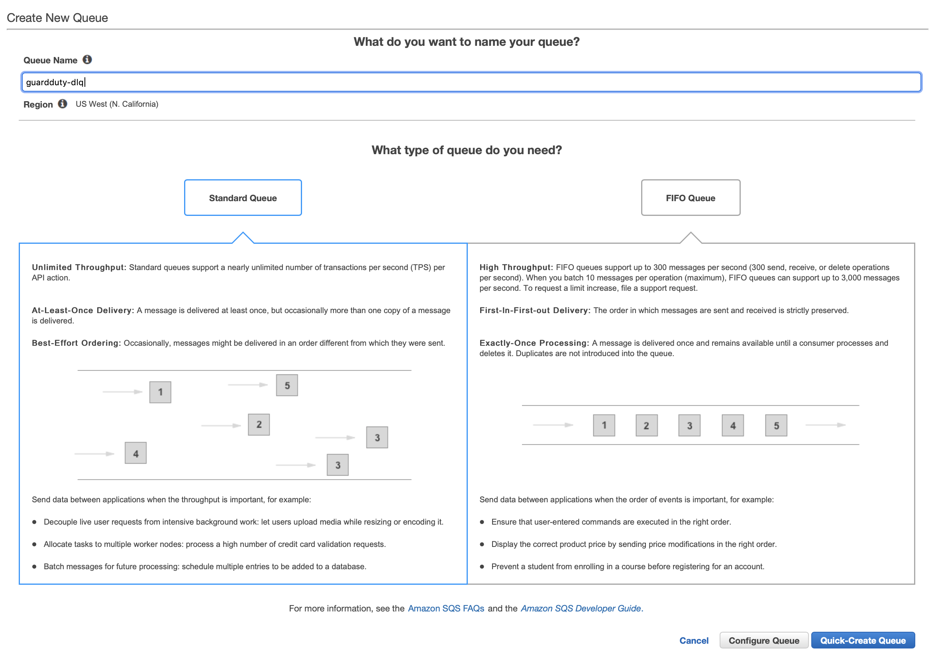
Setup S3 bucket on GuardDuty
Step 4 – Create SQS Queue “guardduty-dlq” for GuardDuty Events

Slide 27
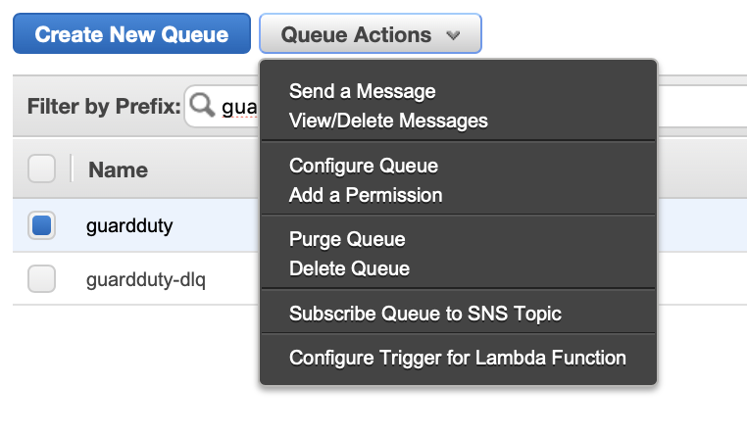
Setup S3 bucket on GuardDuty
Step 5 – Click ”Add a permission” on ‘guardduty’ SQS

Slide 28
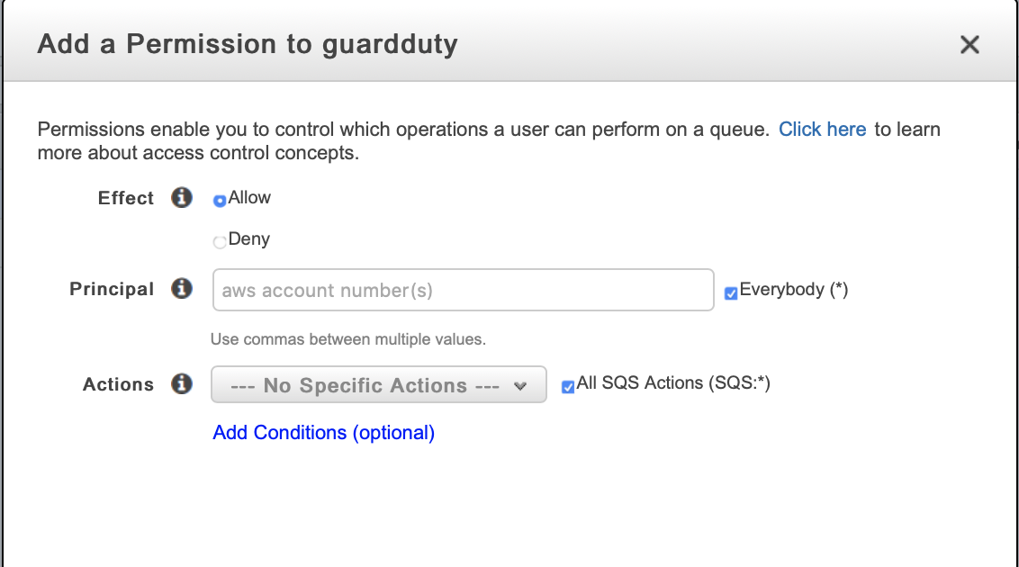
Setup S3 bucket on GuardDuty
Step 6 – Click ”Add a permission” on ‘guardduty’ SQS
Check box Everybody
Check box All SQS

Slide 29
Setup S3 bucket on GuardDuty
Step 7 – Click ”Configure Queue” on ‘guardduty’ SQS

Slide 30
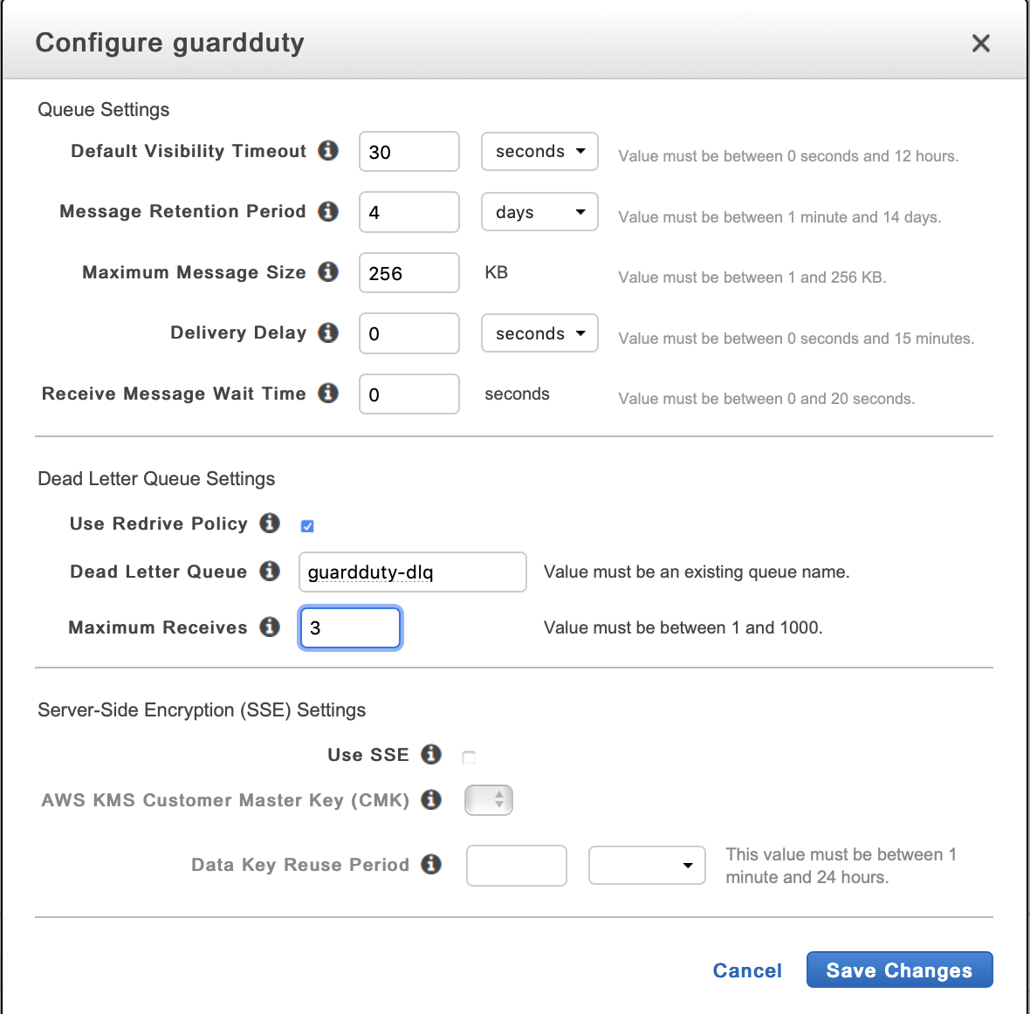
Setup S3 bucket on GuardDuty
Step 8 – Enable Redrive Policy, select the “guardduty-dlq” and maximum to 3
Select guardduty-dlq
Set to 3

Slide 31
Generate Sample Events
Guard Duty Test

Slide 32
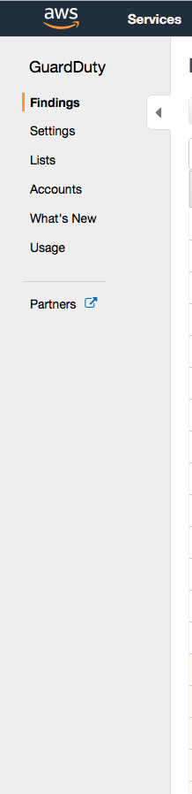
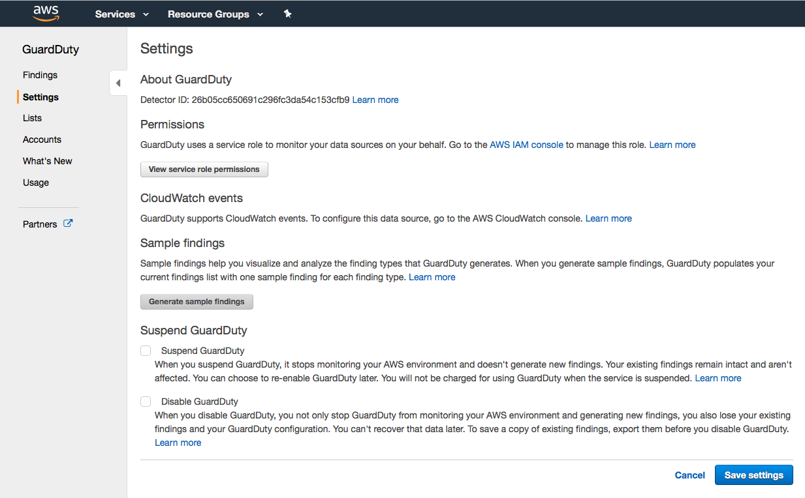
Generate Sample Events Guard Duty
Click Settings
Click “Generate sample findings”

Slide 33
Thanks

